Slide 1

Group 3 – Dashboard Project
Presented By: Group 3

Slide 2
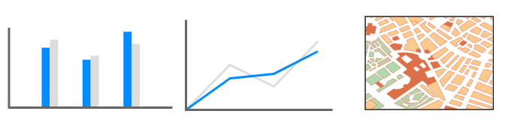
Project Brief
Create a dashboard using R-Shiny and PHS open data on secondary care to investigate what has been happening from 2020 onwards in the acute hospital sector
Key Focus Areas:
1. To what extent is the ‘winter crises’ the media predicts real?
2. How has winter impacted Scotland’s NHS in the past?
3. Potential impact in winter 2022
4. How might the pandemic influence the potential scenario?
Consider: Temporal, Demographic & Geographic Aspects.

Slide 3

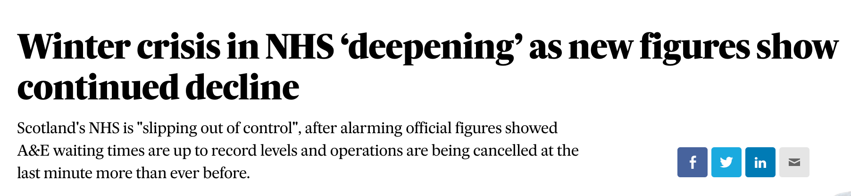
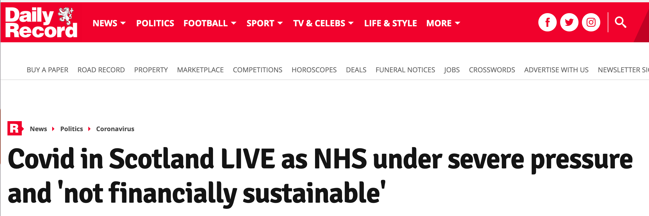
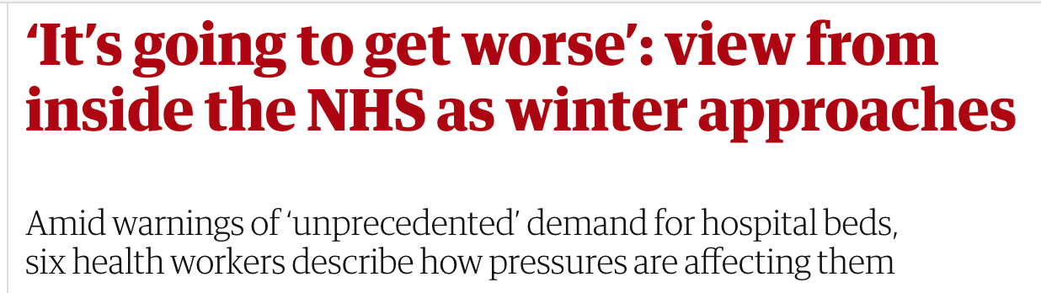
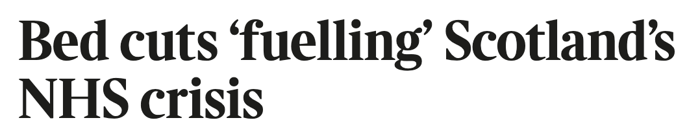
Media Predictions
A&E Waiting Times Increasing
Delayed Discharges
Overwhelming Bed Demand
Increased Admissions
Covid Influence

Slide 4

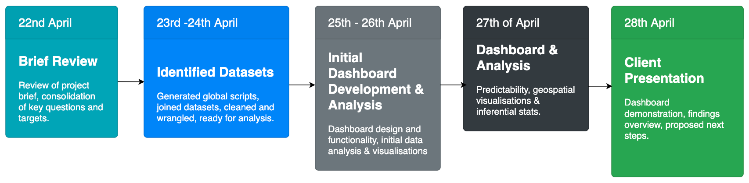
Project Timeline

Slide 5

Dashboard Demonstration
Following our review of the project brief, we developed a dashboard that focused on NHS Performance Vitals (KPI’s):
% Bed Occupancy
A&E Waiting Times
Delayed Discharge
Admissions

Slide 6
Key Findings
Conclusions
What the media predicts has some substance but using data
provides a more accurate insight into these winter predictions.
The pandemic did have an impact on secondary care in the acute hospital sector.
If the pandemic continues we could see similar trends as shown in past years.
Key Findings & Observations:
1. % Bed Occupancy Varies & During Pandemic Occupancy Dropped
2. Delayed Discharge – Most Vulnerable– Admissions Increases
3. Delayed Discharge - Main Reasons related to Health & Social Care
4. A&E - On average hospitals don’t always meet 4 hr target.
5. That further data would enhance predictability modelling.
e.g. Staffing Numbers, vaccination.

Slide 7

End of Presentation – Questions?

